Slide 1
Diversification strategy for engine manufacturing company
Michael Medina
Jennyfer Puentes
Notes:
Within our industry today, there exists trends and troubling signs of decline for its profitability. While this information may be cause for concern and raise fears for employees and questions from customers and other stakeholders, this presentation aims to elaborate on these market statistics, explain factors attributing to this change, and recommend a new direction for the company.

Slide 2
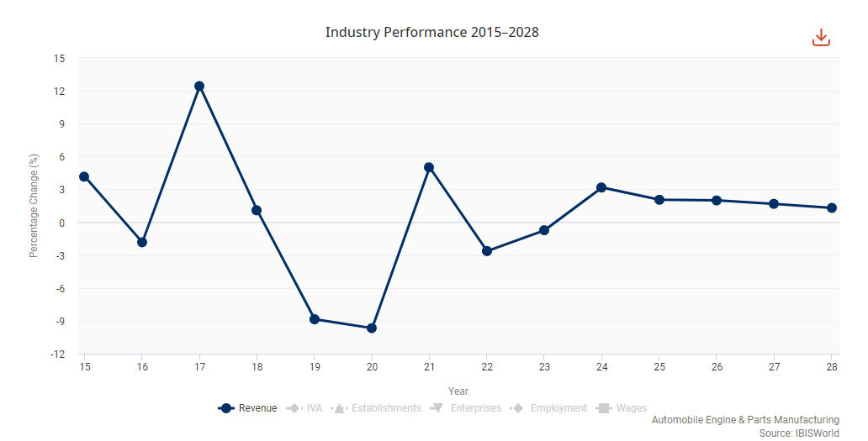
Decline in overall profitability within industry
Source: ibisworld-com,2023
Notes:
The current automotive manufacturing industry is witnessing a plateau in revenues across North America. While a plateau of revenues is not a cause for concern, the effects of this trend are. According to the Bureau of Labor Statistics, the consumer price index rose by 0.2% this June alone, “up 4.8 percent over the year”.(bls.gov,2023) This results in employee pay and other internal stakeholders not witnessing their industries performance matching the rise in inflationary costs of living. Witnessing the industries steady revenue stream by itself does not tell the entire picture, as it can reflect the wages available to pay workers and ensure their financial safety.

Slide 3
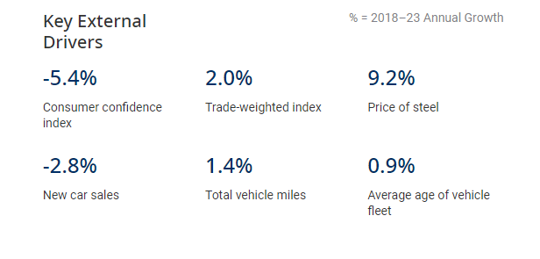
Source: ibisworld-com,2023
Notes:
This slide provides factors that propel the automotive manufacturing industry's performance, with diminishing consumer consumption within this market at -5.4%, an almost 10% increase in materials such as steel, and a declining number of new vehicles being purchased. These statistics are further fueled by a decrease in new car sales, producing fewer new engines. According to Caranddriver.com, "New vehicles made up 6.1 percent of vehicles on the road last year; IHS Markit predicts they will be closer to 5 percent this year."(2021). Our current industry is also lacking behind the used car market, at a 6.2% growth annually, the same period as the statistics above, compared to only a 2% annual growth for the existing industry.

Slide 4
Drivers of industry trend
Source:kbb.com,2021;apnews.com,2023
Notes:
Another cause for the decrease in the automotive manufacturing industry is the rise in consumer demand for electric vehicles. As seen within the visualization, both market and legal trends are causing this emerging industry to take a stronghold. Earlier this year, President Joe Biden produced an executive order for "zero-emissions vehicles to make up half of new cars and trucks sold by 2030". (apnews.com,2023) This can either result in two things, legislation requiring the sales of new non-electric vehicles to come to a halt after a set number, or the production of all non-electric vehicles required to be reduced by fifty percent to allow for the other fifty to be electric. In either scenario, this can result in reduced profits and revenue for the company, which ultimately impacts internal stakeholders through potential department layoffs, reduced work by employees, and fewer materials ordered by suppliers due to the shrinking market share that gas-powered engines are coming to hold.

Slide 5
Percentage of 17 largest car companies going electric globally
Notes:
To further evidence this, 65% of the largest 17 car companies, from General Motors, Mercedes, Jaguar, and Volkswagen, are fully transitioning their vehicles from gasoline to fully electric. These are the future plans of some of these companies as recorded on Forbes.com:
"In June 2021, Audi announced that it will stop manufacturing diesel & petrol cars from 2033. Audi aims to have more than 20 e-models in its line-up by 2025. “
"German automobile giant Volkswagen has announced it would stop the production of engine run cars by 2023-2035 period in Europe.“
"Mercedes-Benz is planning to phase out the ICE vehicles by 2039. “
"Sweden manufacturer Volvo is planning to have only EVs in its global product line-up by 2030." (Forbes.com,2021)
These multi-billion dollar industries and their business analysts, market researchers, and customer relationship management teams have all agreed that this is the best path to adhere to in the upcoming years. While 35% of these companies, such as Ford, Nissan, and Mitsubishi, decided not to convert to fully electric, they are in the minority with this decision, with almost 2/3rd's of these car companies deciding otherwise. This is due to customers demanding more electric vehicle options for future purchases. This is evidenced by the PwC's report of "EV penetration in the US is expected to increase to 30% by 2030".(pwc.com,2023). From future legislation to growing consumer demands, it would behoove the company to follow suit to endure and exist through this upcoming market transition. However, doing so is very costly.

Slide 6

Costs to enter this market
“Top 10 EV companies have invested a total of $17 billion in the technology since 2010”
144% INCREASE in “raw material costs for electric vehicles from $3,381 per vehicle in March 2020 to $8,255 in May”
Source: www.osvehicle.com
Notes:
If this company were to adhere to the strategy of other automobile manufacturers, then electrification would be a well-advised plan of action. However, this comes with a very substantial investment. According to osvehicles.com, 10 electric vehicle companies alone have invested 17 billion to meet rising demands. This equates to 1.7 billion dollars per company investment. If this company were to consider electrification of its new engines and rehauling its facilities to install and manufacture these technologies, it would be very expensive, depending on the revenue this company attains yearly.Additionally, an over 100% increase in the materials to manufacture these technologies per vehicle adds to the overall costs of entering the EV market as an existing engine manufacturing company. If the company did head in this direction and produce electric vehicles, it would have to charge more for its outputs. According to bankrate.com, “The average cost of an EV is $56,437, around $5,000 more than the average price of an entry-level, luxury, gas-burning vehicle”(bankrate.com,2022). It is my professional opinion that this is too costly an investment for this company, and diversification should be sought elsewhere.

Slide 7

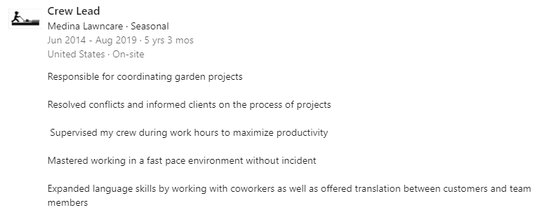
Diversification Decision: Landscaping equipment
Personal experience within industry
Understanding of item/machinery popularity
Awareness of equipment uses and needs from employees
Notes:
My diversification plan for this company exists within the landscaping industry. Before I head further into the explanation, I believe it is appropriate to understand my background and how this strategy came to be. I have worked and operated within a landscaping company for over five years, and with this experience, I have come to understand the inner workings of this industry. As I had the pleasure of interacting with other landscaping companies along with my own, I grew in my understanding of what their machinery existed of, their needs for their equipment, and the tasks they would be accomplishing. I even went as far as questioning them about future newer technologies during my tenure. From my five years as crew lead, I witnessed how many tools and machinery were operated and the major causes for their successes and failures. As time passed and electrification began entering this industry, it was not as successful. With this being the case even today, I propose this plan to each internal and external stakeholder to demonstrate a new pathway this company can undergo in its search for diversification.

Slide 8
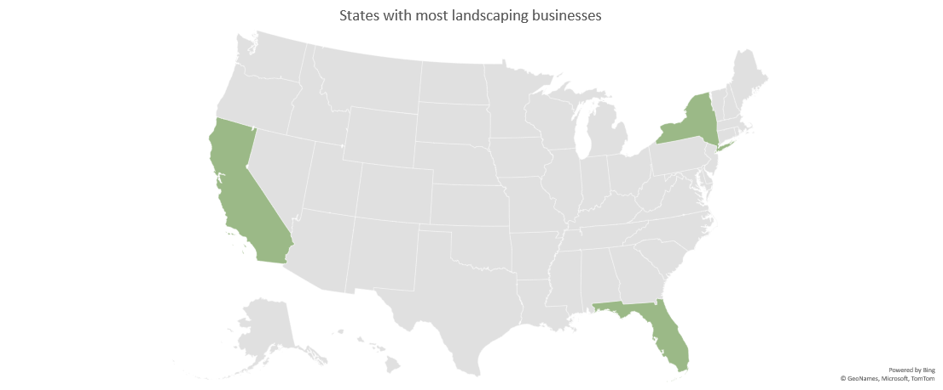
Landscaping manufacturing sales
88.10 billion USD market for global gardening equipment in 2022
6% growth rate compared to 2% for current industry
Source: grandviewresearch.com,2023
Source: landscapeprofessionals.org,2023
Notes:
To reiterate, my proposed diversity plan exists within landscaping manufacturing. As the company currently manufactures automobile engines, it would have the materials and expertise to produce engines for other machinery. Globally, gardening equipment is valued at double the company's existing industry. Within a report by the national association of landscaping professionals, California, New York, and Florida were the "states with the most number of landscaping businesses in the U.S."(2023). The average landscaping company has 305 customers and generates $12,798 per customer.(landscapeprofessionals.org,2023)

Slide 9
Expected Growth
Source:grandviewresearch.com,2023
Notes:
The landscaping manufacturing industry was valued at $88.1 billion in 2022 and is expected to grow by 6.0% annually from 2023 to 2030. (grandviewresearch.com,2023) The automotive engine market is projected to grow by a mere 2% until 2028, 66% lower than the increase in landscaping equipment manufacturing by 2030. This can be evidenced by the fact that the United States continues to be a service economy, contributing “around 77.6 percent to the GDP of the United States”, or $17.93 trillion in 2022.(statista.com,2023) With the assembly of engines for vehicles falling under the manufacturing category, this sector contributed $2.55 trillion in the same year, or 14% of the latter industry. As landscaping equipment is directly tied to the services they are used for and not leisure or overall amenities for consumers, they offer entrance into a new industry that engines for vehicles do not. Most people purchase vehicles for personal reasons and not to perform a service. According to a Gallup poll, “People buy cars for functional reasons, so they need products that perform. They use these products to commute to the office, pick up groceries, help the kids to soccer practice, and tow the family outboard to the lake on Friday.”(2004) The same can not be said for landscaping equipment, as it functions to provide a service and is not multifaceted like a vehicle.

Slide 10


80% of Landscapers prefer gasoline power
Factors Driving Trend
“performance”
“run-time”
“cost”
Source: timesofsandiego.com,2021
Notes:
One question that may emanate from diversifying into the landscaping industry is if electrification will have a future stronghold. This answer is no, as according to one survey in California, most landscapers prefer gas-powered machinery over electric ones.(timesofsandiego.com,2021) This was due to their statements regarding the power output not being up to par, the electric equipment having higher upfront costs, and the duration of usage not coming near where gas-powered engines currently reside. This was also my personal experience when I worked at my landscaping company; landscapers did not wish to transition their machinery because it would be very costly initially, and it would take further time to learn how to use it when they were so accustomed to ICE equipment. From five years ago to now, this has not appeared to change, as there continues to be a demand for gas power. Moving into this new industry will impact internal stakeholders by promoting future growth in their operations and enhanced security their work will exist in time. For external stakeholders, this ensures that their desired tools endure and they are not forced to migrate to the new technology, extending their project timelines and increasing the number of workers required to complete one job due to electric machinery's underperformance.

Slide 11
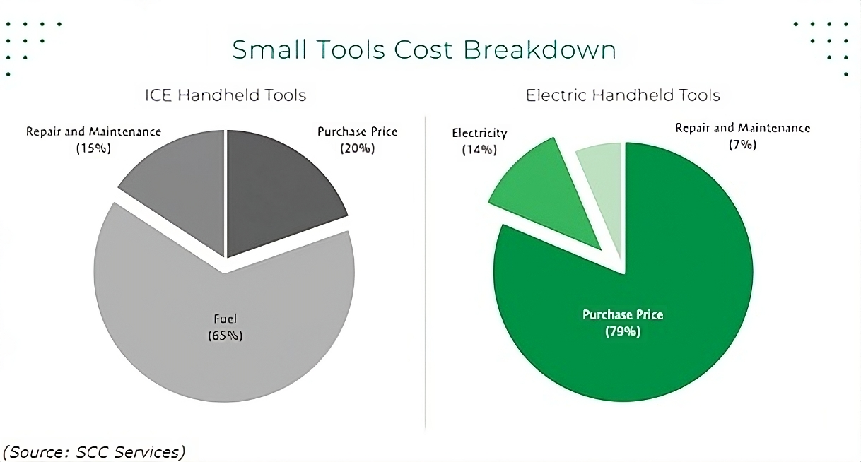
59% price difference
Source:(turfmagazine.com)
Notes:
To further expand on cost, according to turfmagazine.com, electric machinery can cost 75% more than its ICE counterpart. With 20% of an ICE tool’s overall costs being its initial purchasing price, an electric tool’s purchasing price accounts for a 59% increase in the initial product. For many landscapers in the United States, their annual salary is a fraction of the pay of the average American. Landscapers, on average, make $28,952 in the United States, with the 90th percentile making $36,000.(zippa.com,2023) Compared to the salary of the average American being 59,428, this is still a $20,000 difference compared to the highest average paid landscapers nationwide. Diversifying into this new industry would benefit internal stakeholders and positively impact external stakeholders, from the community to customers. If landscapers are forced to pay more for their equipment, they must charge more to the people they serve. This eventually causes further competition with landscapers who can afford the technology and those who can not, requiring them to purchase equipment in worse condition but is more affordable, or charge less to exist within the market. The impact that moving to this new industry will have on the organization is serving to provide quality equipment for external stakeholders such as landscapers at a fraction of the costs of electric equipment.

Slide 12
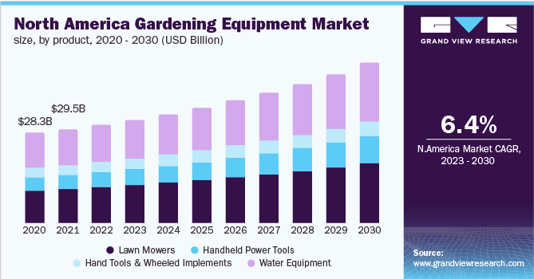
Likelihood of success
Notes:
With the previously mentioned statistics in mind, it can be concluded that the future demands for industries such as automotive engine manufacturing is electrification and alternative energies. If the company fails to act and diversify accordingly, it can witness itself beginning to break even in profits, and ultimately go bankrupt from the lack of sales. With the plateauing of the existing industry demonstrated in the first slide, extensive growth is not likely for another five years. However, evidence from grand view research demonstrates that overall gardening equipment is projected to increase annually by 6.4% for the next seven years. This considers recent sales of various equipment such as lawnmowers, power tools, and watering equipment. With the highly valued market for landscaping services and the growth of gardening equipment required to perform these services, the likelihood of this company’s diversification success is high. Unlike automobiles, producing engines for this machinery does not guarantee its usage in any way other than personal. For example, “73 percent of American commuters use their own car to move between home and work”, showing personal transpiration as the largest usage of vehicles.(statista.com,2023) Unless individuals rent their car, use it to provide deliveries, or do anything that provides services, their vehicle does not exist to add additional value except for convenience and commuting. This is not the case for landscaping equipment, as its sole purpose is maintenance on land or shrubbery. In order to perform these operations, landscapers require tools to do so. This is how this industry continues to witness its engines perform services and add value to themselves. After witnessing that almost 78% of the US economy is attributed to services, entering this industry promotes opportunity for more customers and higher demand.

Slide 13

Summary of Data
59% lower upfront costs for ICE equipment
88.10 billion market value as of 2022
Low desire for alternative technologies
6.4% new growth V.S. 2% existing growth
Notes:
Summarizing the findings of the research conducted within this presentation, important points to emphasize are the differences in profits and growth between the two industries and the lower threats of electrification that exist within landscaping manufacturing. The visuals aim to demonstrate that as customers demand more electrification, automobile manufacturers will have to either invest in this technology or be phased out in the future. For the current company, this can just as easily happen if they do not diversify into a market that is not so heavily invested in this technology. The visualizations convey that the new industry is a very safe way for the company to exist and grow with minimal fears of emerging eliminations or requirements of high investments in electrification. As the company already owns and operates within engine manufacturing, it can easily take its expertise and reputation over to this new industry without paying for any large costs associated with entering this market. Additionally, adhering to engine manufacturing within this new market would ensure the company’s success through being a cheaper alternative to electric equipment, providing in-demand customer needs, and enhancing sales by existing within a highly valued sector of the economy. As the research suggests, diversification would not only seek to solve the problem of a diminishing gas-powered new car market, but ensure that the company can attain future growth in a new industry. Engine manufacturing within landscaping equipment is very profitable, and with the issue of electrification overwhelming the new car manufacturing market, this diversity strategy can solve this problem.

Slide 14
References
Bankrate. (n.d.). Electric Car Outlook: 2022 Stats Worth Knowing. Retrieved from Electric Car Outlook: 2022 Stats Worth Knowing | Bankrate
Bureau of Labor Statistics. (n.d.). Consumer Price Index. Retrieved from https://www.bls.gov/cpi/
Car and Driver. (n.d.). Average Age of Vehicles on the Road Is Almost 12 Years. Retrieved from https://www.caranddriver.com/news/a33457915/average-age-vehicles-on-road-12-years/
Daly, M., & Krisher, T. (2023, April 10). AP sources: EPA car rule to push huge increase in EV sales. AP News. Retrieved from https://apnews.com/article/biden-electric-vehicles-epa-tailpipe-emissions-31bf8104f44d81b988249483f1a79117
Forbes Wheels. (n.d.). Automaker EV Plans: Who’s Doing What, When? Retrieved from https://www.forbes.com/wheels/news/automaker-ev-plans/
Gallup Business Journal. (n.d.). Why Car Buyers Buy. Retrieved from https://news.gallup.com/businessjournal/13606/why-car-buyers-buy.aspx#:~:text=People%20buy%20cars%20for%20functional,to%20the%20lake%20on%20Friday.
Grand View Research. (2023). Gardening equipment market size, share & trends analysis report by product, by end user, by distribution channel, by region, and segment forecasts, 2023 - 2030. Retrieved from https://www.grandviewresearch.com/industry-analysis/gardening-equipment-market
IBISWorld. (2023). Automotive engine & parts manufacturing in the US - market research report. Retrieved from https://my-ibisworld-com.ezproxy.snhu.edu/us/en/industry/33631/industry-at-a-glance
National Association of Landscape Professionals. (n.d.). Industry Statistics - National Association of Landscape Professionals | NALP | Landscape Industry Careers | LoveYourLandscape.org | LandscapeIndustryCareers.org | LandscapeProfessionals.org | NALP.org | National Association of Landscape Professionals | NALP | Landscape Industry Careers | LoveYourLandscape.org | LandscapeIndustryCareers.org | LandscapeProfessionals.org | NALP.org. Retrieved from https://www.landscapeprofessionals.org/LP/About/Industry-Statistics/LP/Media/landscape-industry-statistics.aspx#:~:text=Size%20of%20the%20Industry&text=Florida%20(8%2C758%20businesses)%2C%20California,landscaping%20businesses%20in%20the%20U.S.
OSVehicle. (n.d.). What’s the cost of manufacturing an electric car? Retrieved from https://www.osvehicle.com/whats-the-cost-of-manufacturing-an-electric-car/
Statista. (n.d.). Service sector of the U.S. - Statistics & Facts. Retrieved from https://www.statista.com/topics/7997/service-sector-of-the-us/#topicOverview
Times of San Diego. (2021, October 8). Landscapers decry high cost of new California mandate to buy electric tools. Retrieved from https://timesofsandiego.com/business/2021/10/08/landscapers-decry-high-cost-of-new-california-mandate-to-buy-electric-tools/
Tucker, S. (2023, January 17). New car sales fell in 2022, but new electric car sales rose dramatically. Kelley Blue Book. Retrieved from https://www.kbb.com/car-news/new-car-sales-fell-in-2022-but-new-electric-car-sales-rose-dramatically/
Turf Magazine. (n.d.). Gas vs Electric Outdoor Power Equipment: Real World Costs. Retrieved from https://turfmagazine.com/gas-vs-electric-outdoor-power-equipment-real-world-costs/
Zippia. (n.d.). Landscaper Salary - Zippia. Retrieved from https://www.zippia.com/landscaper-jobs/salary/

